Slide 1

MACHINE LEARNING

Slide 2
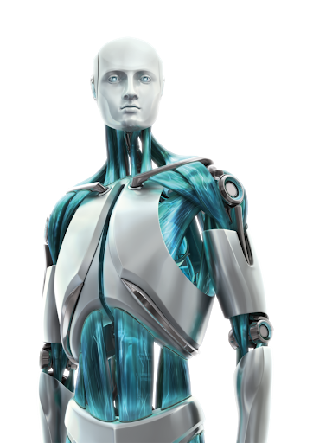


THE IDEA OF MACHINE LEARNING
LEARN FROM EXPERIENCE
LEARN FROM DATA
TAKES INSTRUCTIONS

Slide 3
WHAT IS MACHINE LEARNING?
“Machine Learning is the field of study that gives computers the ability to learn without explicitly programmed.”

Slide 4
TRADITIONAL SYSTEMS VS MACHINE LEARNING
Traditional Systems
DATA
PROGRAM
RULE BASED PROGRAMS
OUTPUTS
DATA
MACHINE LEARNING ALGORITHMS
OUTPUTS
Machine Learning

Slide 5
WHY MACHINE LEARNING IS A BUZZWORD THESE DAYS?
There has been explosion in amount of data created every second with the use of internet.
2.7 Zettabytes of data exists on our digital universe.
149,513 emails are sent every minute
3.8 Million Google searches are made every minute
448,800 emails are constructed every minute.
500 hours of videos uploaded every hour on youtube.

Slide 6
APPLICATIONS OF MACHINE LEARNING
Virtual personal assistants.
Recommendation engines
Fraud detection
Self driving cars
Stock movement prediction
Virtual Reality and AR
Speech recognition
Customer sentiment analysis
Health Care

Slide 7
TYPES OF MACHINE LEARNING
Training is done on labelled data.
Output label is known to us.
There are two types of supervised learning regression and classification.
UNSUPERVISED LEARNING
SUPERVISED LEARNING
Training is done on unlabelled data.
Infer patterns from data without reference to known labels.
E.g - Customer segmentation.
It features an algorithm that improves upon itself.
Learning is done based on trial and error.
Favourable outputs are encouraged and unfavourable outputs are discouraged.
REINFORCEMENT LEARNING

Slide 8
CLASSIFICATION AND REGRESSION
TRANSACTION AMOUNT | CLASS
2,000 | NO FRAUD
40,000 | FRAUD
20,000 | FRAUD
10,000 | NO FRAUD
8,000 | NO FRAUD
EXPERIENCE | SALARY
2 | 35,000
3 | 38,000
4 | 42,000
5 | 45,000
7 | 48,000
DEPENDENT
VARIABLE
INDEPENDENT VARIABLE(X)
INDEPENDENT VARIABLE
DEPENDENT
VARIABLE(Y)
CONTINUOUS DEPENDENT VARIABLE
CATEGORICAL DEPENDENT VARIABLE
REGRESSION PROBLEM
CLASSIFICATION PROBLEM

Slide 9
MACHINE LEARNING PROCESS
PROBLEM
STATEMENT
Imputing missing values.
Scaling and normalising features.
Feature engineering
Transforming categorical features into numeric
Supervised models.
Unsupervised models.
Reinforcement models.
Confusion matrix.
Accuracy
Precision & Recall
Train Test validation
Checking overfitting and underfitting
PREPROCESSING
MODELING
MODEL EVALUATION
DATA
Divide data into training and testing
Apply model as per problem statement.
Evaluate model performance

Slide 10
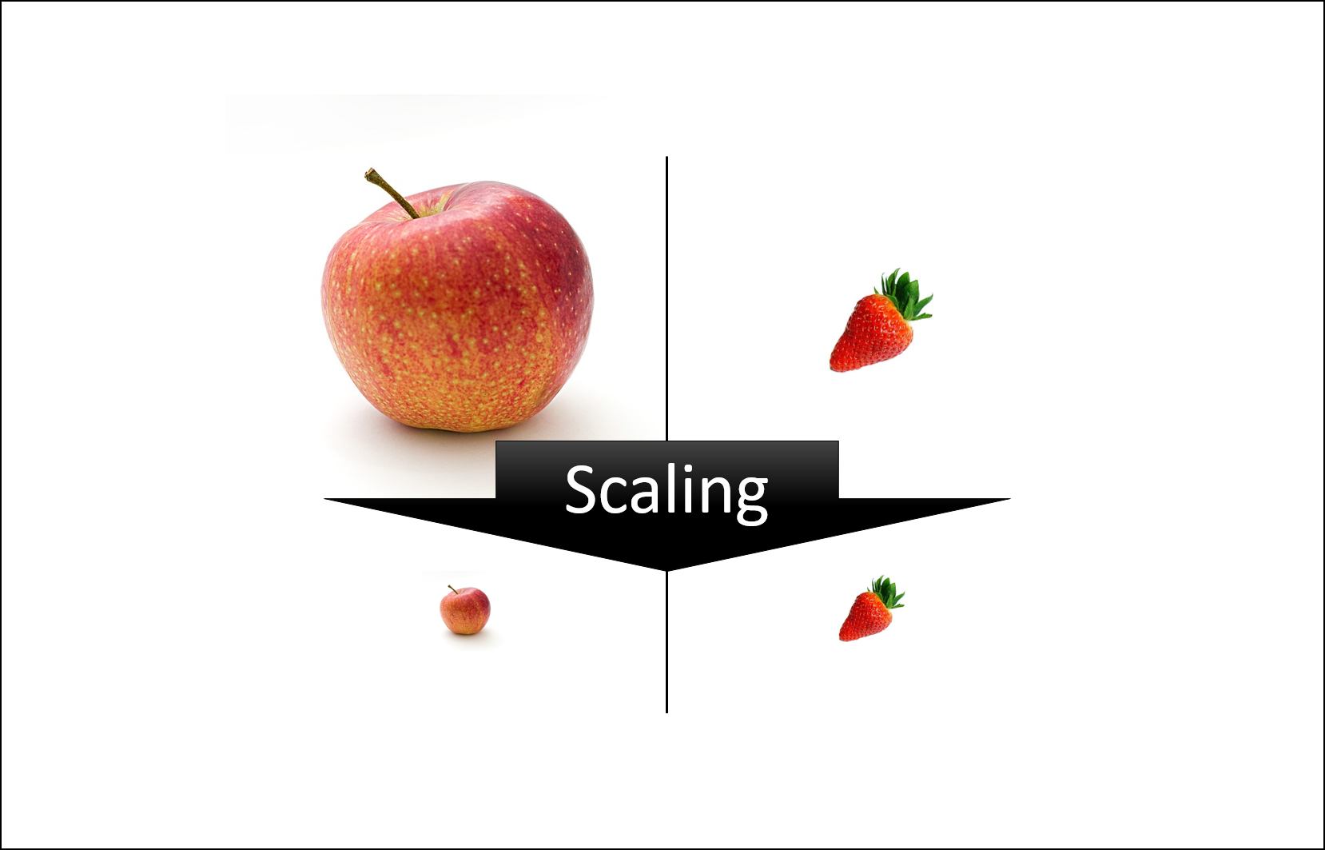
Feature Scaling
Feature scaling in machine learning is one of the most critical steps during the pre-processing of data before creating a machine learning model.
Scaling can make a difference between a weak machine learning model and a better one.
The most common techniques of feature scaling are Normalization and Standardization.

Slide 11
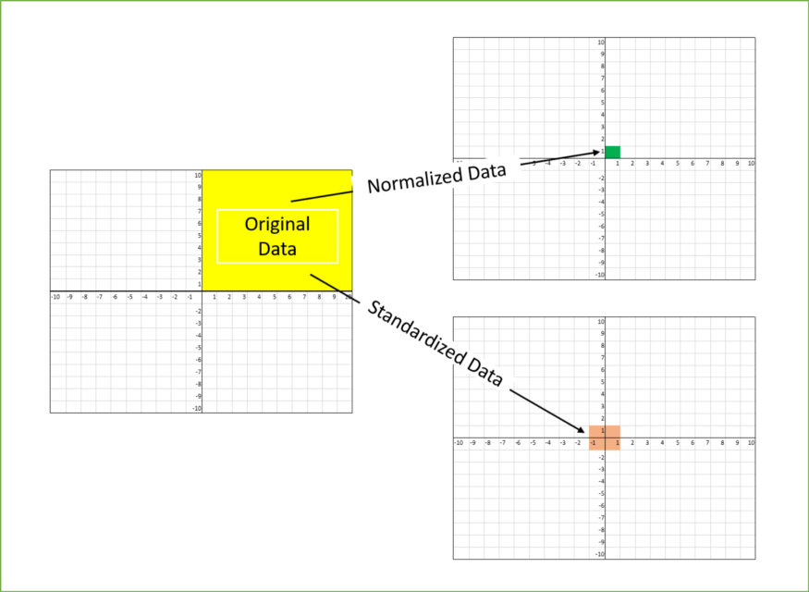
Normalization is used when we want to bound our values between two numbers, typically, between [0,1] or [-1,1].
While Standardization transforms the data to have zero mean and a variance of 1, they make our data unitless.

Slide 12
Machine learning algorithm just sees number — if there is a vast difference in the range say few ranging in thousands and few ranging in the tens, and it makes the underlying assumption that higher ranging numbers have superiority of some sort.
So these more significant number starts playing a more decisive role while training the model.

Slide 13
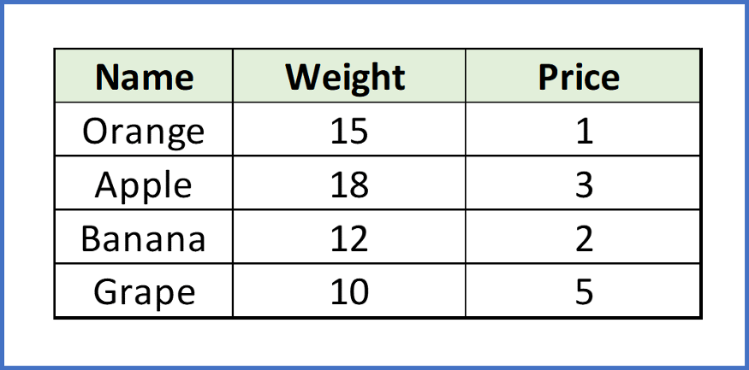
Suppose we have two features of weight and price, as in the below table. The “Weight” cannot have a meaningful comparison with the “Price.” So the assumption algorithm makes that since “Weight” > “Price,” thus “Weight,” is more important than “Price.”

Slide 14
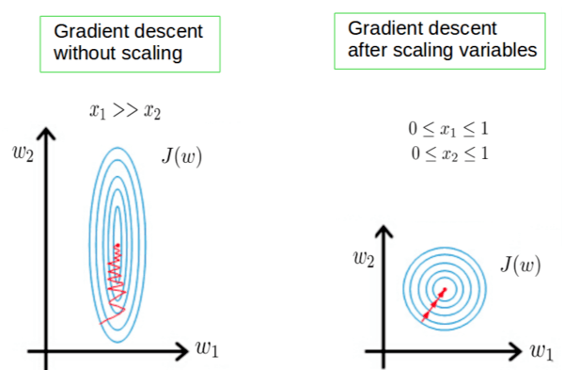
So these more significant number starts playing a more decisive role while training the model. Thus feature scaling is needed to bring every feature in the same footing without any upfront importance. Interestingly, if we convert the weight to “Kg,” then “Price” becomes dominant.
Another reason why feature scaling is applied is that few algorithms like Neural network gradient descent converge much faster with feature scaling than without it

Slide 15

The Standard Scaler assumes data is normally distributed within each feature and scales them such that the distribution centered around 0, with a standard deviation of 1.
Centering and scaling happen independently on each feature by computing the relevant statistics on the samples in the training set. If data is not normally distributed, this is not the best Scaler to use.
Feature scaling is an essential step in Machine Learning pre-processing. Deep learning requires feature scaling for faster convergence, and thus it is vital to decide which feature scaling to use.

Slide 16
Evaluation Metrics
Confusion Matrix
F1 Score
Gain and Lift Charts
Kolmogorov Smirnov Chart
AUC – ROC
Log Loss
Gini Coefficient
Concordant – Discordant Ratio
Root Mean Squared Error
Cross Validation (Not a metric though!)

Slide 17
A confusion matrix is an N X N matrix, where N is the number of classes being predicted. For the problem in hand, we have N=2, and hence we get a 2 X 2 matrix. Here are a few definitions, you need to remember for a confusion matrix :
Accuracy : the proportion of the total number of predictions that were correct.
Positive Predictive Value or Precision : the proportion of positive cases that were correctly identified.
Negative Predictive Value : the proportion of negative cases that were correctly identified.
Sensitivity or Recall : the proportion of actual positive cases which are correctly identified.
Specificity : the proportion of actual negative cases which are correctly identified.

Slide 18
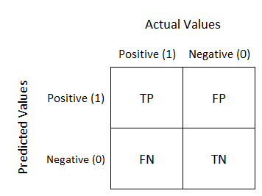

Slide 19
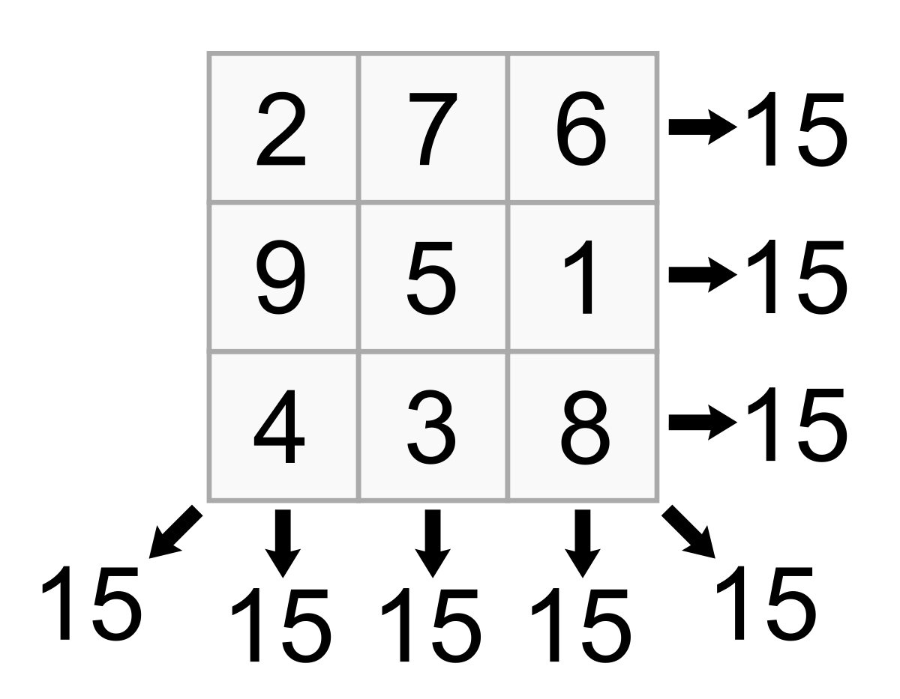

Slide 20
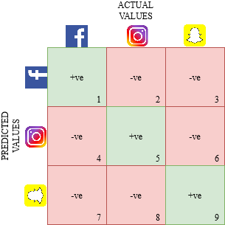
In some cases we will be having more features to be considered. Then Confusion matrix will get N number variables

Slide 21
TIME TO CODE AND GET HANDS DIRTY WITH DATA!

